Slide 1

BiteKing POS & Billing System
A Modern, Cross-Platform Restaurant Point-of-Sale Solution Built with C++17 and Qt 6 Framework
TEAM MEMBERS
SECTION & INSTRUCTOR
ARCHITECTURE
Arshdeep Sahota | Alhan Mahfouz | Syed Razi
Section 301 | Prof. Sanaa
C++17 / Qt6 / CMake

Slide 2

Problem & Motivation
Operational Bottlenecks
The BiteKing Solution
Traditional restaurant workflows suffer from manual order logging, billing delays, and error-prone tax/discount calculations during rush hours.
BiteKing bridges digital restaurant management with smooth front-of-house desktop operations using a high-performance C++ backend.
Delivers real-time table state tracking, automated HST (13%) tax calculations, polymorphic menu discounting, and file persistence.
Waitstaff need instant seat state updates, cashiers require validated change processing, and managers lack real-time financial metrics.

Slide 3
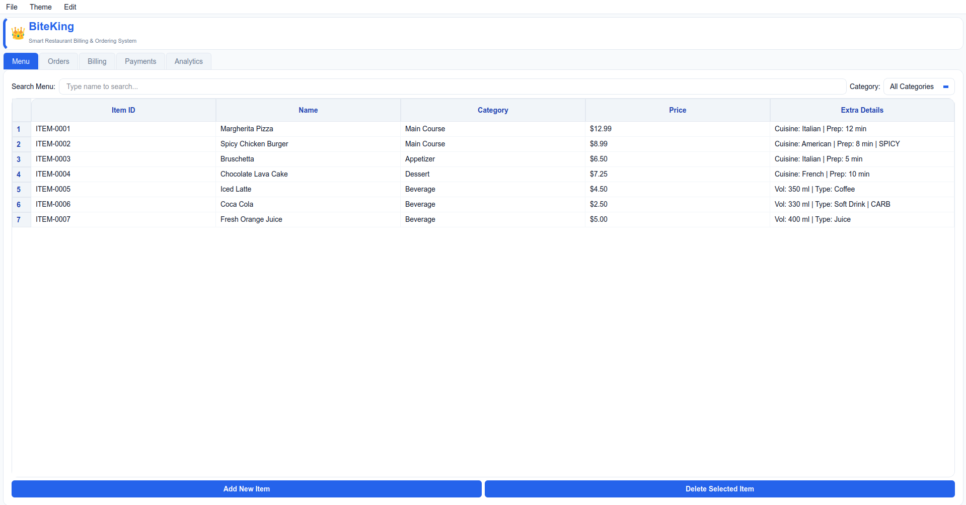
System Architecture & Overview
5 Modular Operating Views
→
Menu Explorer: Live dish filtering, dynamic item additions, and price/type updates.
→
Order Manager: Assigns orders to active tables with bounded spinner controls.
→
Billing System: Previews subtotal, 13% tax rate, happy-hour discounts, and net total.
→
Payment Processing: Validates Cash/Card methods with automated change calculations.
→
Real-Time Analytics: Evaluates daily sales totals and top-selling menu items.

Slide 4

Software Class Design
Object Class Architecture
Base Hierarchy: MenuItem abstract class derived into specialized FoodItem and BeverageItem entities.
Table Ownership: DiningTable manages CustomerOrder via std::unique_ptr for single ownership memory safety.
Shared Memory: RestaurantManager manages catalog items through std::shared_ptr.

Slide 5





Core C++ OOP Principles
Inheritance & Abstraction
Runtime Polymorphism
Encapsulation & Protection
MenuItem defines abstract pure virtual displayItem() = 0. Extended by FoodItem (cuisine, prep time) and BeverageItem (volume, fizzy status).
Virtual methods calculateFinalPrice() and calculateDiscountedPrice() are invoked polymorphically across heterogeneous menu lists at runtime.
All core attributes remain private or protected. Setter methods enforce numeric guardrails preventing negative prices or empty string IDs.

Slide 6
Advanced C++ Features
Templates & Overloading
STL & Smart Pointers
Generic Analytics: AnalyticsEngine operates polymorphically over Bill and Payment histories using SFINAE compile-time dispatch.
STL Containers: std::vector for cache-friendly order line storage and std::map for fast table queries.
Operator Overloading: Overloaded comparison operator== for item IDs and friend stream output operator<< for standard output logging.
Smart Pointer Memory: std::shared_ptr for shared menu catalog instances and std::unique_ptr for exclusive table lifecycle management.

Slide 7
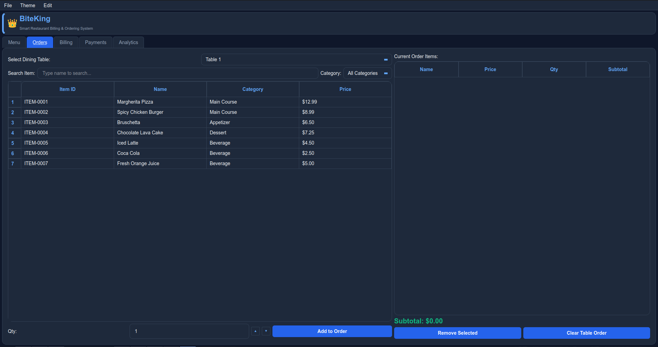
GUI Demonstration & Qt6 Architecture
→
Responsive Layout Packing: Nested QHBoxLayout, QVBoxLayout, and QGridLayout wrappers prevent UI stretching.
→
Signal & Slot Communication: Event-driven architecture binds table seat button clicks directly to order updates.
→
Dynamic QSS Theme Switcher: Dark and Light modes with custom input field overrides.

Slide 8
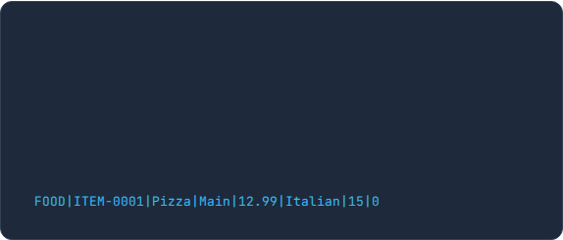

Data Persistence & File I/O
Polymorphic Serialization
Transaction Logging
Menu catalog stored in structured pipe-delimited local file format menu.txt.
The DataManager persistent logging subsystem reads and writes transaction streams.
Starts each record line with concrete type tags (FOOD or BEV) enabling seamless factory reconstruction on startup:
Saves completed bills, customer orders, and payment histories to track financial metrics and historical sales continuity across application restarts.

Slide 9
Testing Matrix & Edge Cases
Test Case | Target Input / Action | Expected Behavior | Status
Menu Addition Validation | Short Name "A", Price: $0.00 | Rejected with validation popup message | PASS
Duplicate ID Check | Add existing ID "ITEM-0001" | Addition blocked; duplicate warning shown | PASS
Boundary Limits | Order Quantity: -1 or 101 | Input bounded strictly by QSpinBox [1..100] | PASS
Insufficient Cash | Cash Tendered $10 for $15 Bill | Payment blocked with "Insufficient Cash" warning | PASS
Card Payment Lock | Select "Card" mode | Cash field disabled; payment auto-locked to total | PASS

Slide 10



Technical Challenges & Solutions
Linux GTK Theme Collision
QComboBox Arrow Disappearance
Challenge: Unstyled QLineEdit search boxes inherited dark system text on dark backgrounds when switching themes.
Challenge: Applying custom border styles disabled native dropdown arrow rendering in combo boxes.
Solution: Explicitly styled QLineEdit and QTableCornerButton elements inside stylesheet rules.
Solution: Implemented pure CSS/QSS downward arrows using border tricks in custom stylesheet rules.
Input Validation for Menu Items
Challenge: Menu items have strict requirements – ID format, name length/letters, price range, valid categories. Invalid data must not crash the system.
Solution: All setters validate input and use safe defaults to prevent invalid data from crashing the system.

Slide 11

Project Conclusion & Key Achievements
Summary of Accomplishments
100%
→
Robust Modern C++: Fully leveraged C++17 OOP, smart pointers, templates, and STL collections.
→
Smooth Desktop GUI: Built an intuitive Qt 6 interface for waitstaff, cashiers, and managers.
→
Fault-Tolerant Input: Guarded against invalid inputs, boundary errors, and invalid payments.
Leak-Free Memory Safety
→
Future Scope: SQLite database integration, multi-terminal network synchronization.

Slide 12



Questions & Discussion
Thank you for your time and attention! We welcome any questions regarding BiteKing POS, software class design, C++ implementation, or Qt GUI design.
C++ Architecture Topics
Qt GUI & Styling
Technical Q&A Spot
Smart Pointers (unique_ptr vs shared_ptr), Abstract Base Classes, and Template SFINAE Engine.
Signals & Slots, QSS Theme Switcher, Custom Event Handling, and Table View State Updates.
[ Blank spot reserved for specific instructor or audience discussion questions ]

